Slide 1
TOPIC NAME
“EXPENSES MANAGER SYSTEM”
SUBMITTED BY:
Jayashree Subhash Zalte.
PRN: (2124UCEF1065)

Slide 2
INTRODUCTION
Expense Manager is launched for Android Expense Manager, the latest and one of best running version in Finance category. It enables users to create expense, list down them based on different categories and check or search for specific entry. GensobrazilCpp has two main classes using object-oriented programming paradigms: one is Expense (which represents an individual expense, containing the attributes name of cost, amount and category) and a second class named as ExpenseManager which performs managing actions for handling a collection of all objects called Expenses. A straightforward system provides clear, helpful insight for people to understand where their money goes.

Slide 3
USES
An expense manager system monitors, controls, and analyzes the expenses of an individual or company. Major uses:
1.Tracking Expenses: Monitor daily, weekly, or monthly expenses to understand personal spending habits.
2. Budgeting: Set budgets across different categories and track adherence.
3. Financial Analysis: Generate reports to analyze expenditure and identify where savings are possible.
4. Receipt Management: Digitally store and organize receipts for easy access and record-keeping.
5.Accumulation of Expenses: the provision of categorizing expenses, for instance, in types such as food or travel, for easy record keeping.
6.Reporting reporting in graphical forms to understand financial health.Integration. Integration with bank accounts and credit card(s) automatically tracks the expenses .
7.Tax Preparation. Easy collection of expenses of the filing of tax. Overall, an expense manager system helps in better financial awareness and assists one in making informed financial decisions.

Slide 4
CODE
#include <iostream>
#include <string>
#include <vector>
class Expense {
private:
std::string name;
double amount;
std::string category;
public:
Expense(const std::string& name, double amount, const std::string& category)
: name(name), amount(amount), category(category) {}
std::string getName() const { return name; }
double getAmount() const { return amount; }
std::string getCategory() const { return category; }

Slide 5
friend std::ostream& operator<<(std::ostream& os, const Expense& expense) {
os << "Name: " << expense.name << ", Amount: " << expense.amount
<< ", Category: " << expense.category;
u return os;
}uu
u};
class ExpenseManager {
private:
std::vector<Expense> expenses;
public:
void addExpense(const Expense& expense) {
expenses.push_back(expense);
std::cout << "Expense added successfully.\n";
}
void viewExpenses() const {
if (expenses.empty()) {
std::cout << "No expenses recorded.\n";
return;
}

Slide 6
}
for (const auto& expense : expenses) {
std::cout << expense << "\n";
}
}
void searchExpense(const std::string& name) const {
bool found = false;
for (const auto& expense : expenses) {
if (expense.getName() == name) {
std::cout << expense << "\n";
found = true;
break;
}
}
if (!found) {
std::cout << "Expense not found.\n";
}
}
};

Slide 7
int main() {
ExpenseManager manager;
manager.addExpense(Expense("Groceries", 150.50, "Food"));
manager.addExpense(Expense("Electricity Bill", 75.25, "Utilities"));
manager.addExpense(Expense("Gym Membership", 50.00, "Fitness"));
std::cout << "\nViewing all expenses:\n";
manager.viewExpenses();
std::cout << "\nSearching for 'Groceries':\n";
manager.searchExpense("Groceries");
std::cout << "\nSearching for 'Rent':\n";
manager.searchExpense("Rent");
return 0;
}

Slide 8
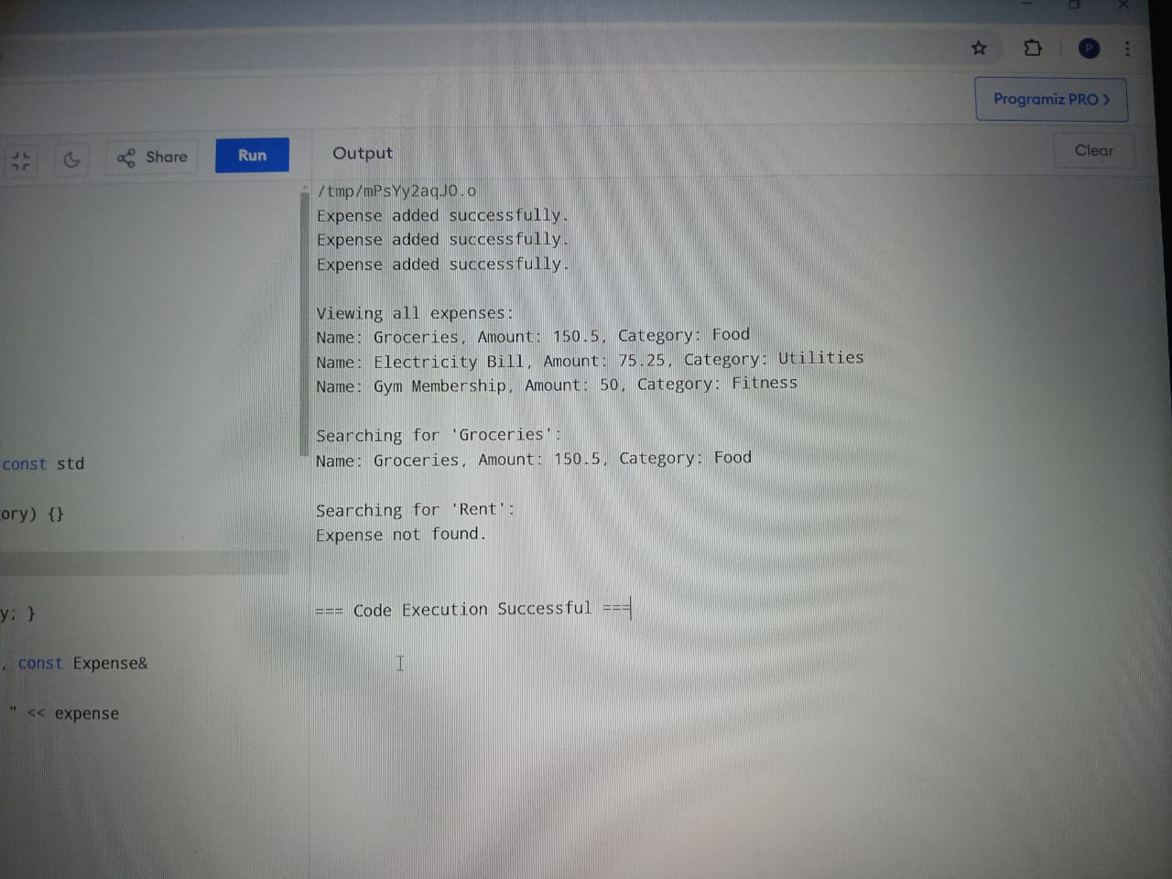
OUTPUT

Slide 9
CONCLUSION
To sum up, the Expense Manager is a minimalist solution for keeping track of personal funds. It gives some level of freedom to the users by enabling them add, read and search for expenses which is very conducive in keeping tabs on their spending so far over a period of time or just enough required information to help you make better financial decisions.
This straight forward expense management system shows object-oriented programming principles through the use of classes to structure data and functionalities. The Expense class simply acts as blueprint (an already-defined user-created data type) for expense objects; the Expense Manager, meanwhile, else provides methods and operations that allow us to those define / manipulate expenses. This code allows you to create, see and search for our expenses but if we want more functionalities as categorization or edit an expense, reporting etc this just a start of a basic example tool that anyone could use in order to help him control their financial life.

Slide 10
THANK YOU

